Slide 1
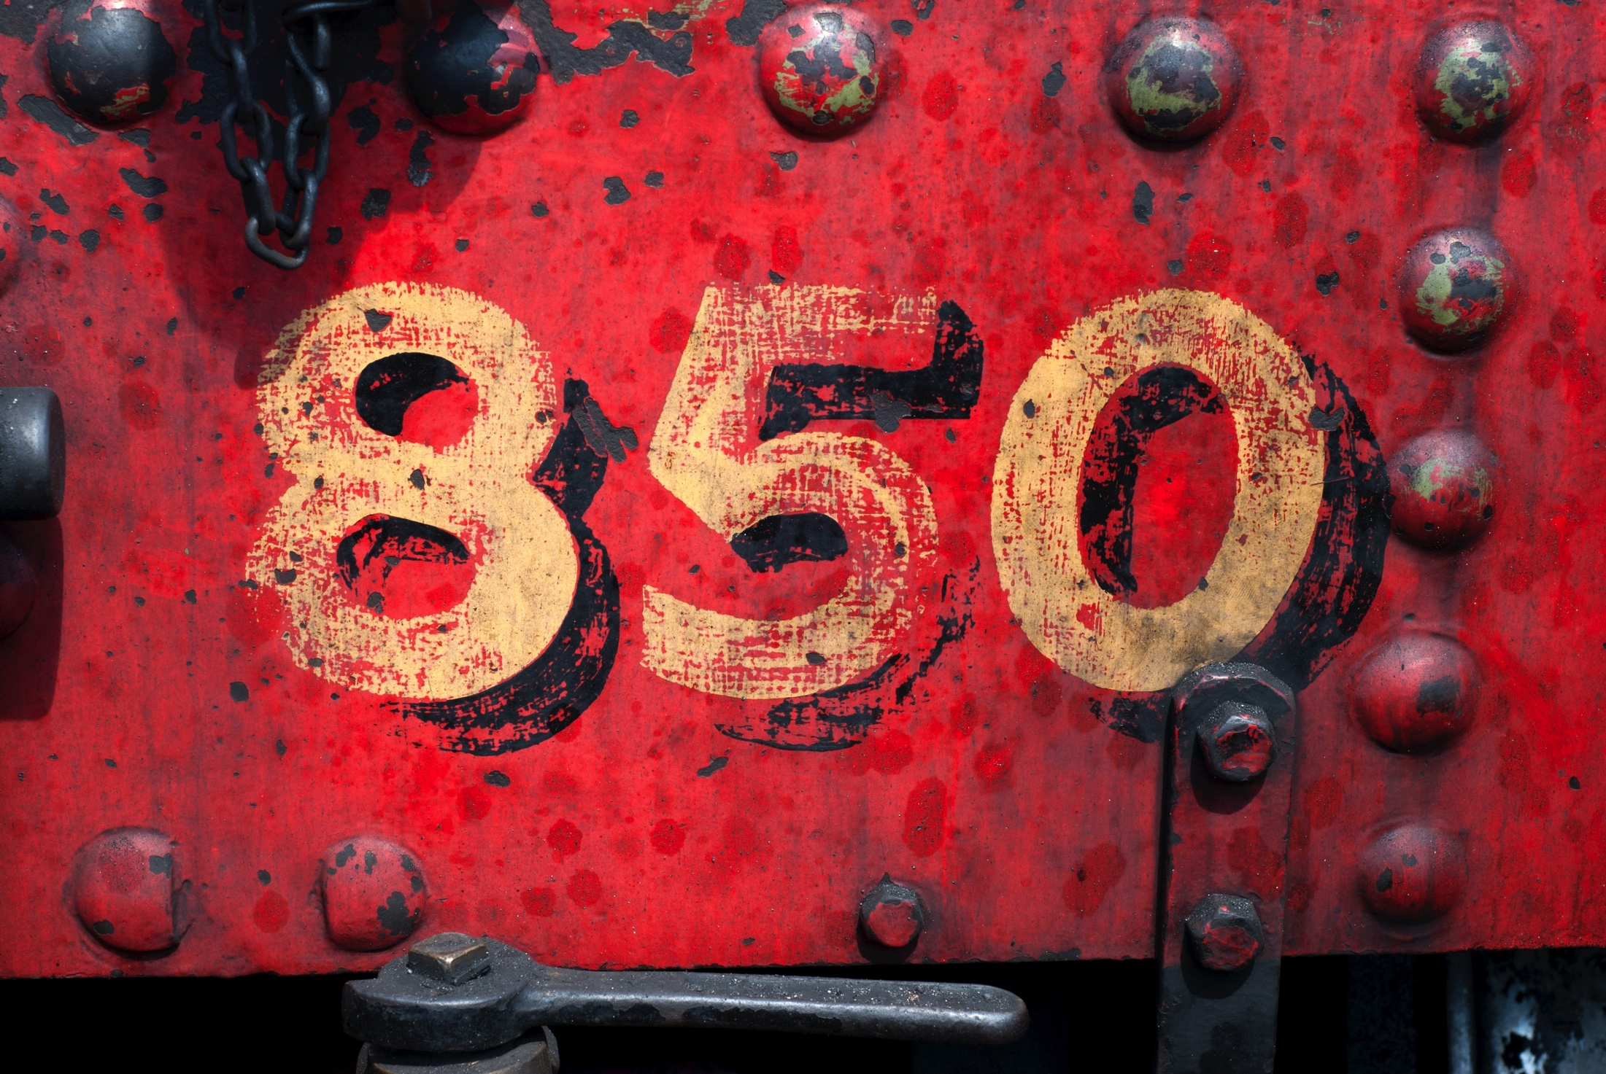
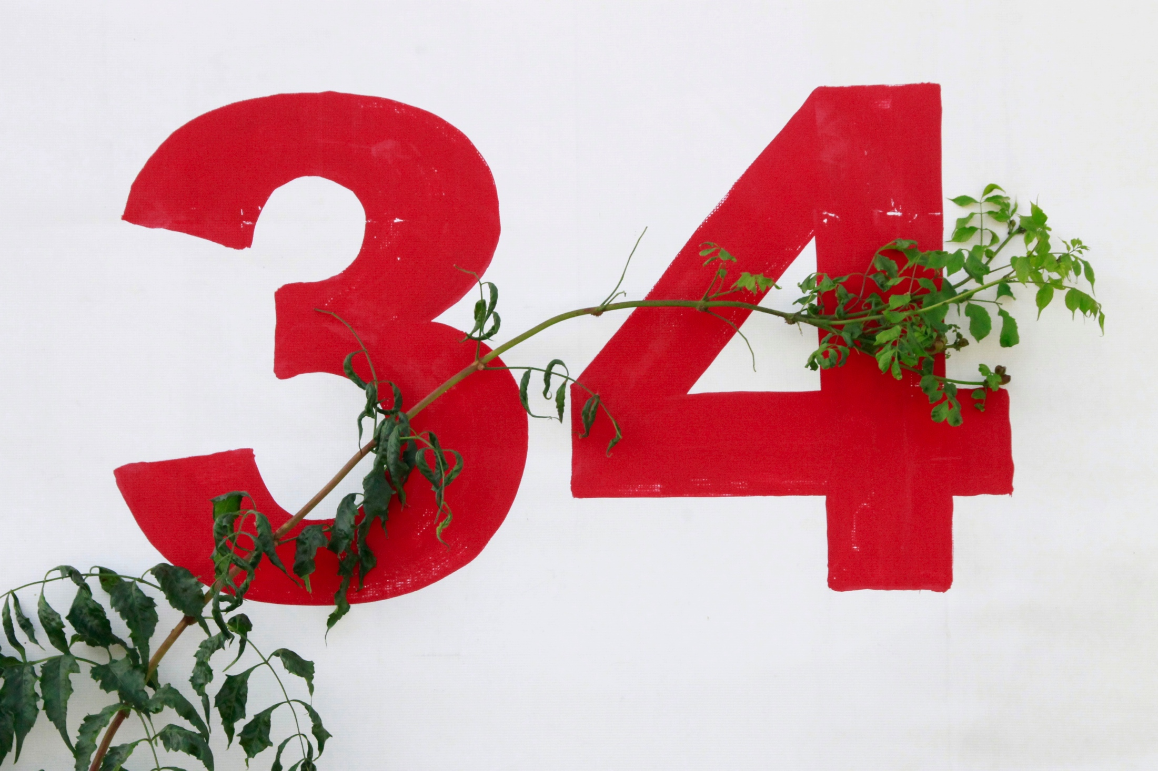
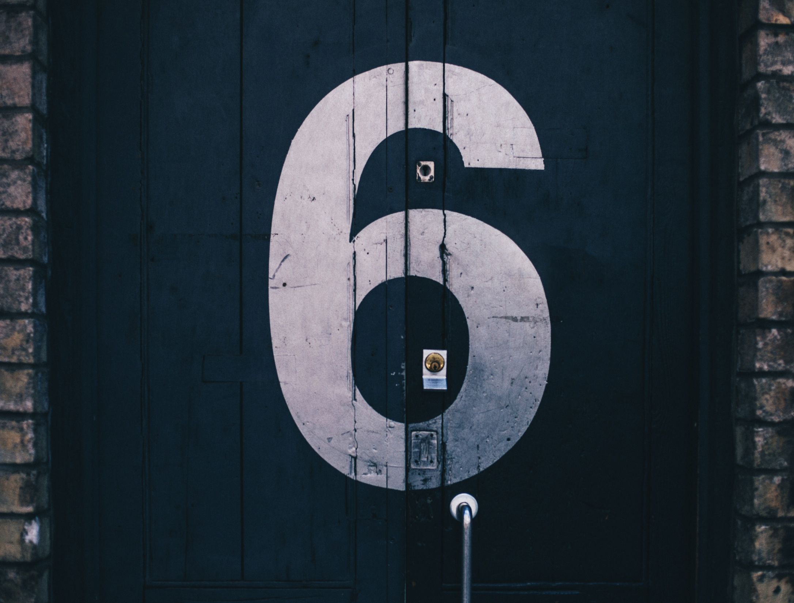
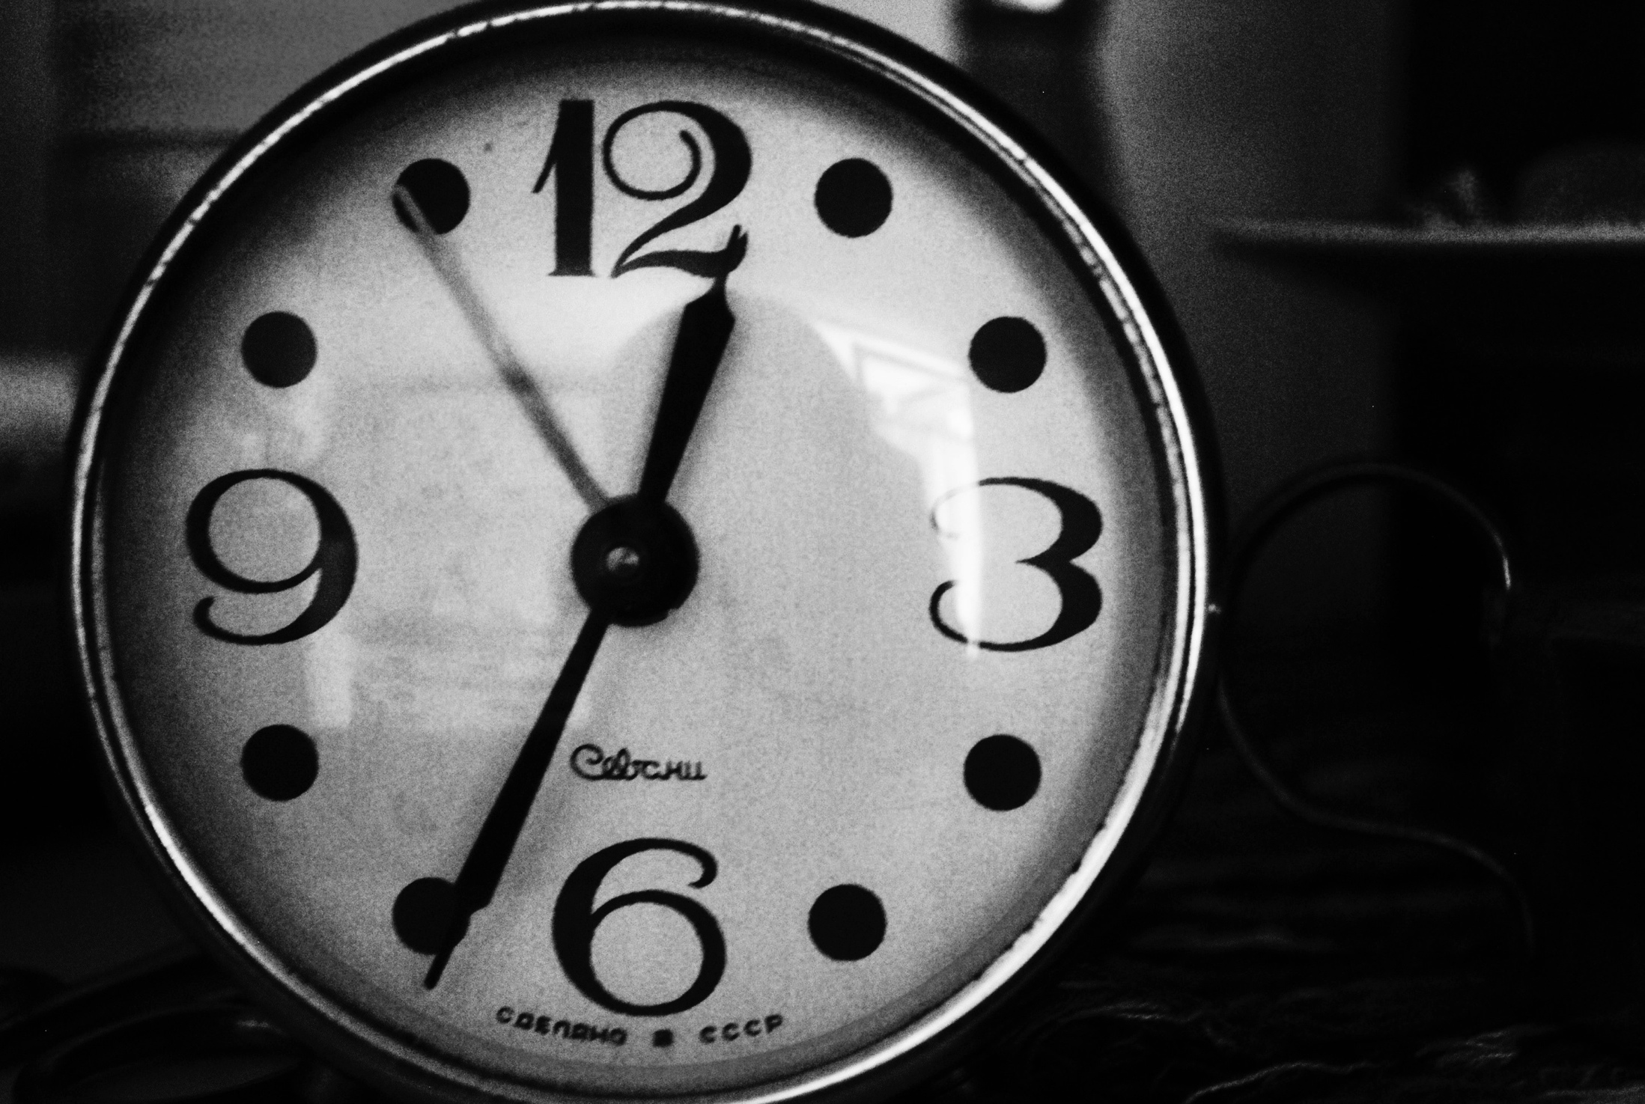
New York State Math Test
2020
Presented by Serena Trinkwalder

Slide 2
Test Resources
www.engageny.org

Slide 3
Test Design - Grade 3
Day | Multiple Choice | Short Response | Extended Response | # of Questions | Approximate time needed
1 | 25 | 0 | 0 | 25 | 55-65 minutes
2 | 8 | 6 | 1 | 15 | 60-70 minutes

Slide 4
Test Design – Grade 4
Day | Multiple Choice | Short Response | Extended Response | # of Questions | Approximate time needed
1 | 30 | 0 | 0 | 30 | 65-75 minutes
2 | 8 | 6 | 1 | 15 | 65-75 minutes

Slide 5
Test Design – Grade 5
Day | Multiple Choice | Short Response | Extended Response | # of Questions | Approximate time needed
1 | 30 | 0 | 0 | 30 | 80-90 minutes
2 | 8 | 6 | 1 | 15 | 70-80 minutes

Slide 6
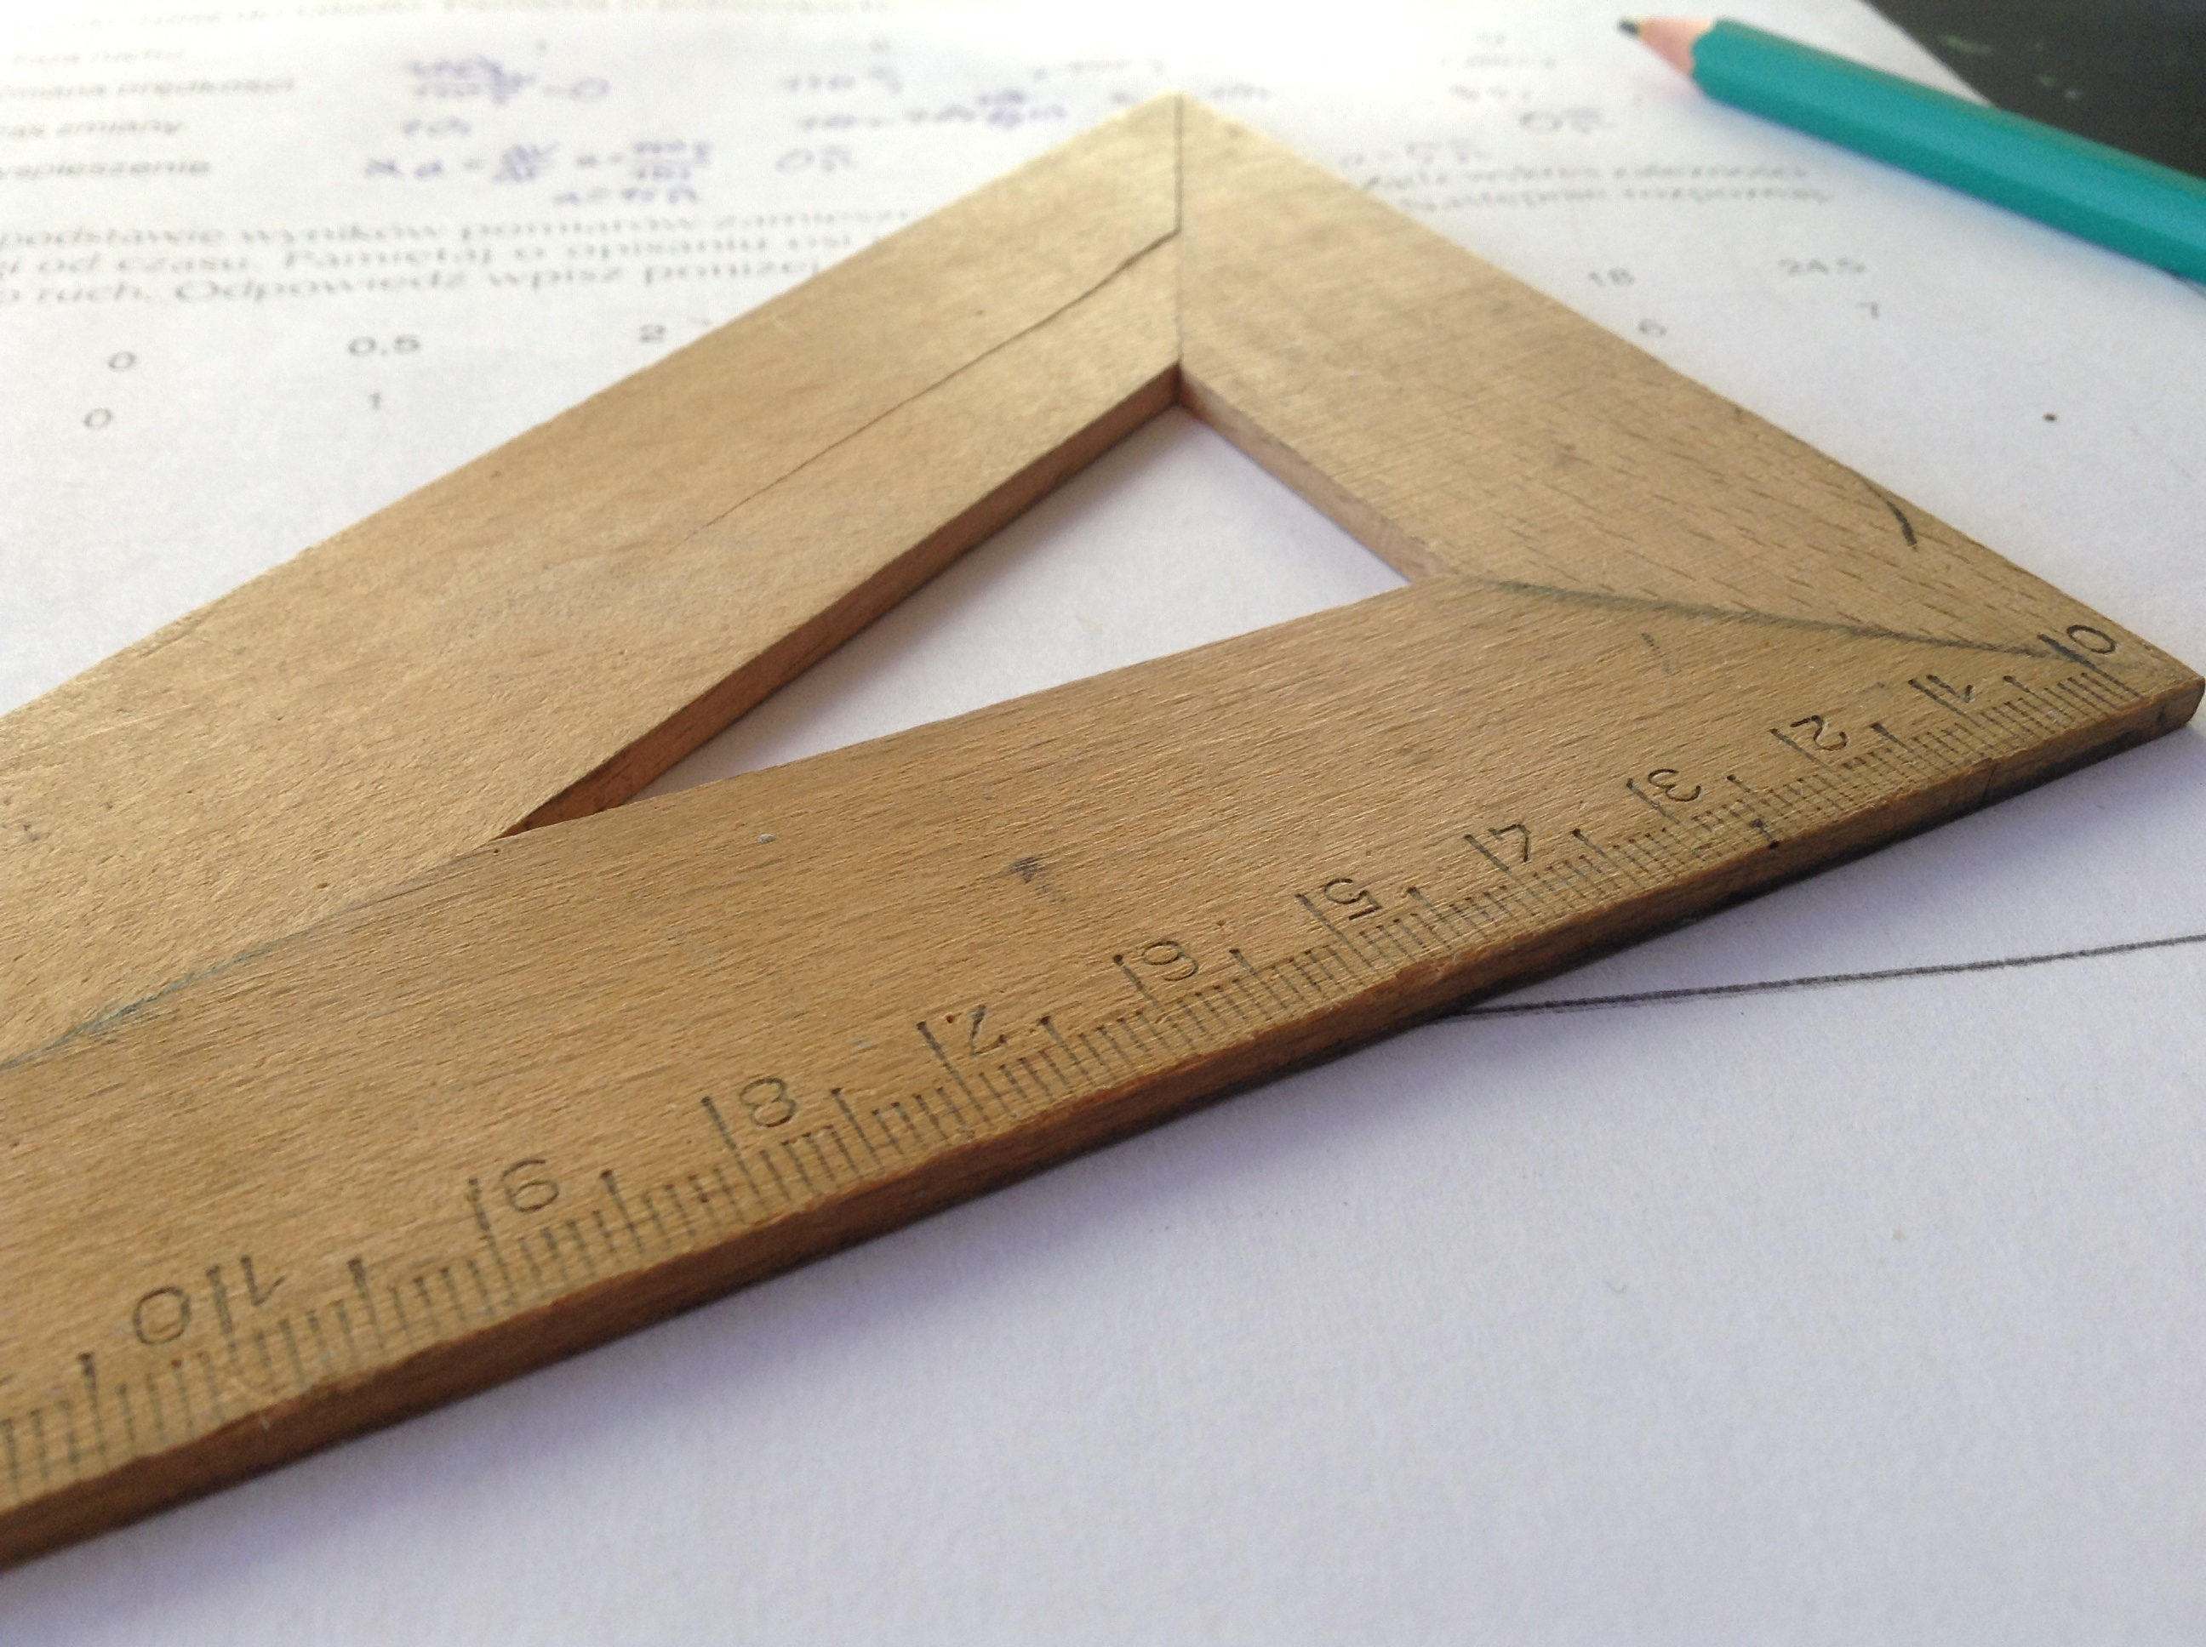
What’s Covered?

Slide 7
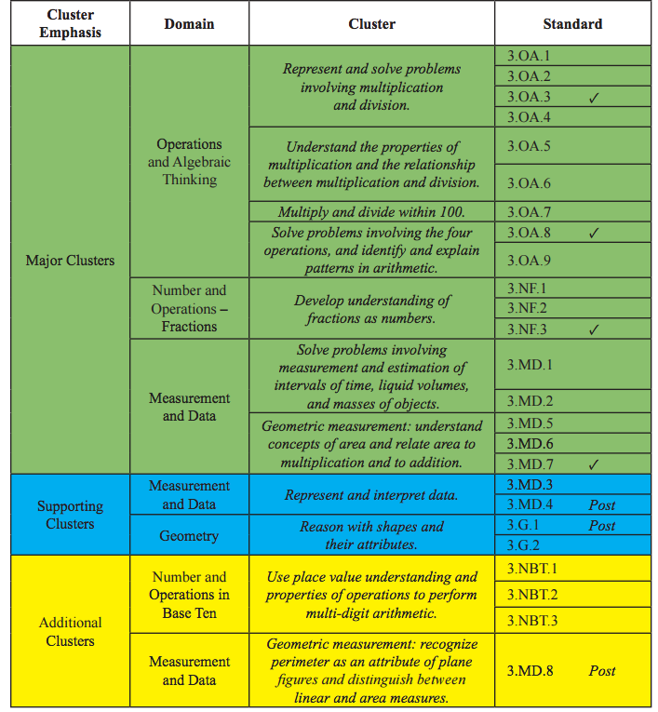
3rd Grade
70-80%
10-20%
5-10%

Slide 8
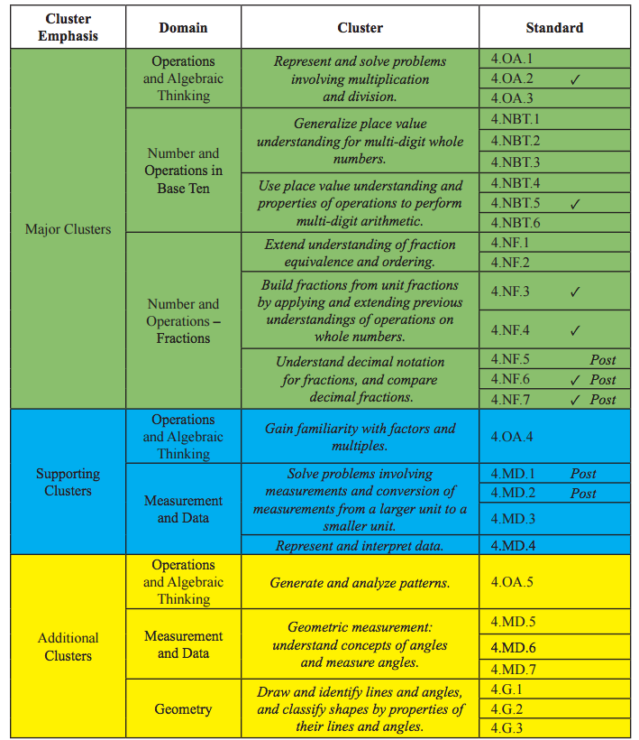
4th Grade
70-80%
10-20%
5-10%

Slide 9
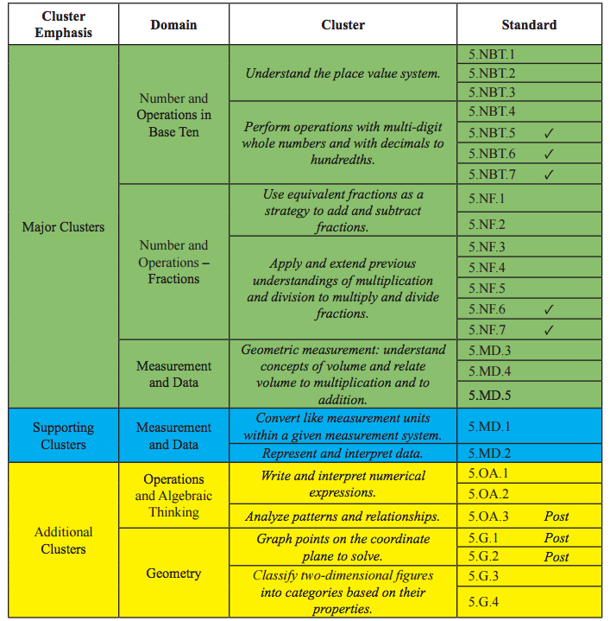
5th Grade
70-80%
10-20%
5-10%

Slide 10
Scoring the Test
Percent of Test Points
 | Number and Operations in Base Tens | Number and Operations - Fractions | Operations and Algebraic Thinking | Measurement and Data | Geometry
3rd | 5-15% | 15-25% | 40-50% | 15-25% | 5-15%
4th | 20-30% | 20-30% | 15-25% | 15-25% | 5-15%
5th | 20-30% | 30-40% | 5-15% | 20-30% | 5-15%

Slide 11
Preparing for a Test
Year long work problem solving and interpreting story problems through Math Journals and Independent Class Work
2 math periods a day - 1 unit based & 1 preparation
Small groups for targeted Instruction
Groups are based on data from Benchmark test as well as unit assessments
Groups are very targeted – students move in and out of groups based on mastery of concepts, skills and strategies

Slide 12
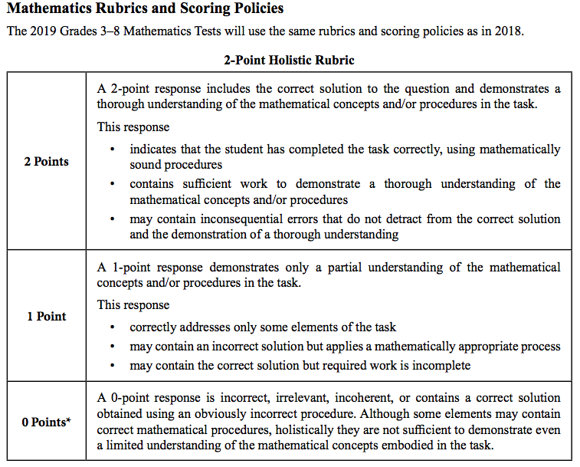

Slide 13
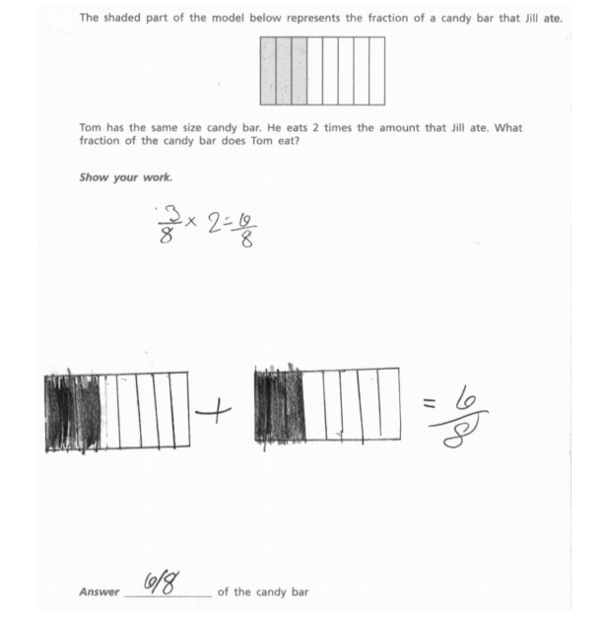
4th Grade
4th Grade

Slide 14
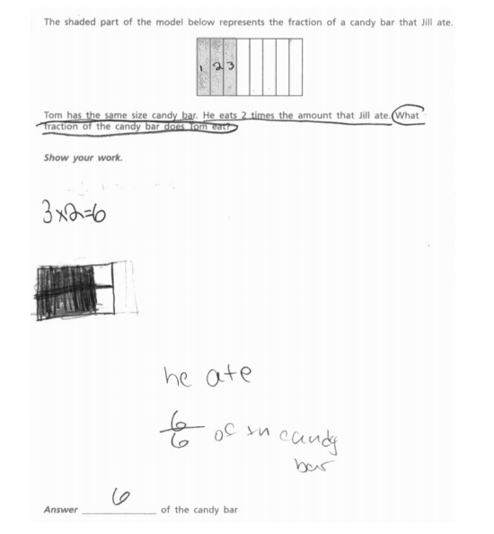

Slide 15
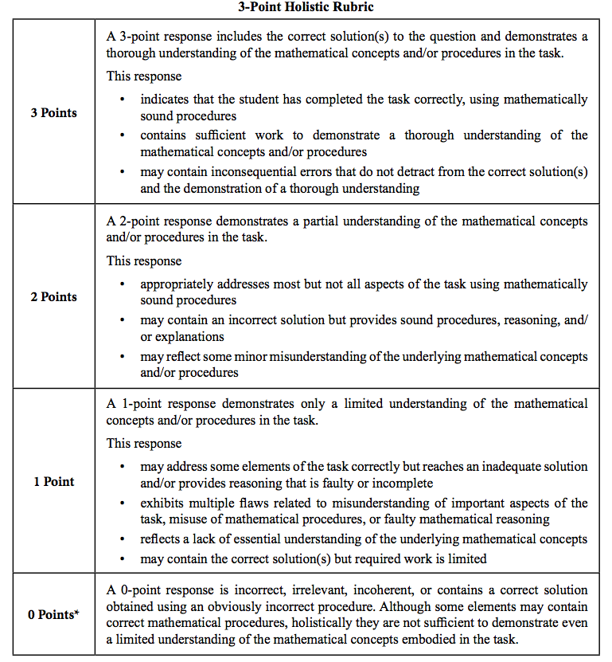

Slide 16
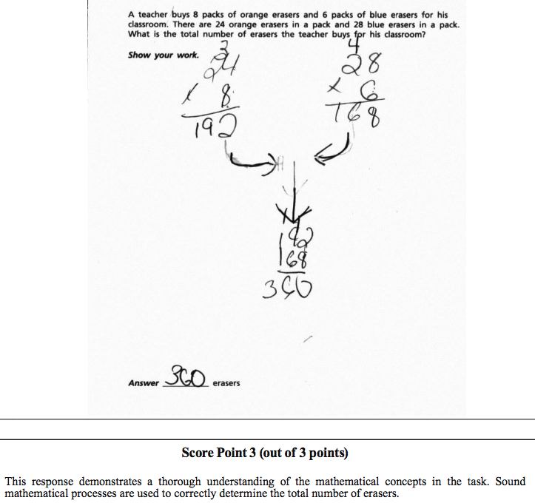
4th Grade

Slide 17
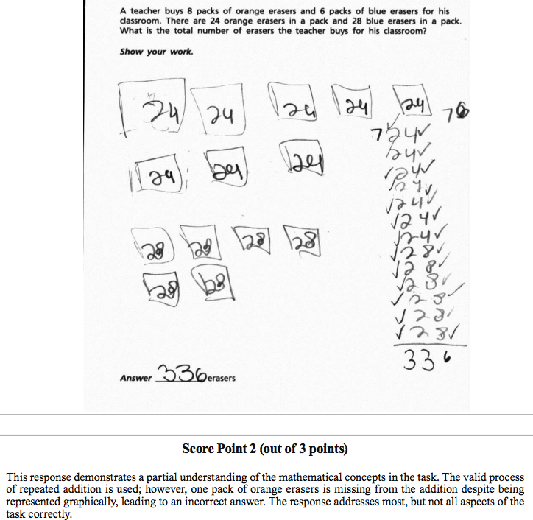

Slide 18
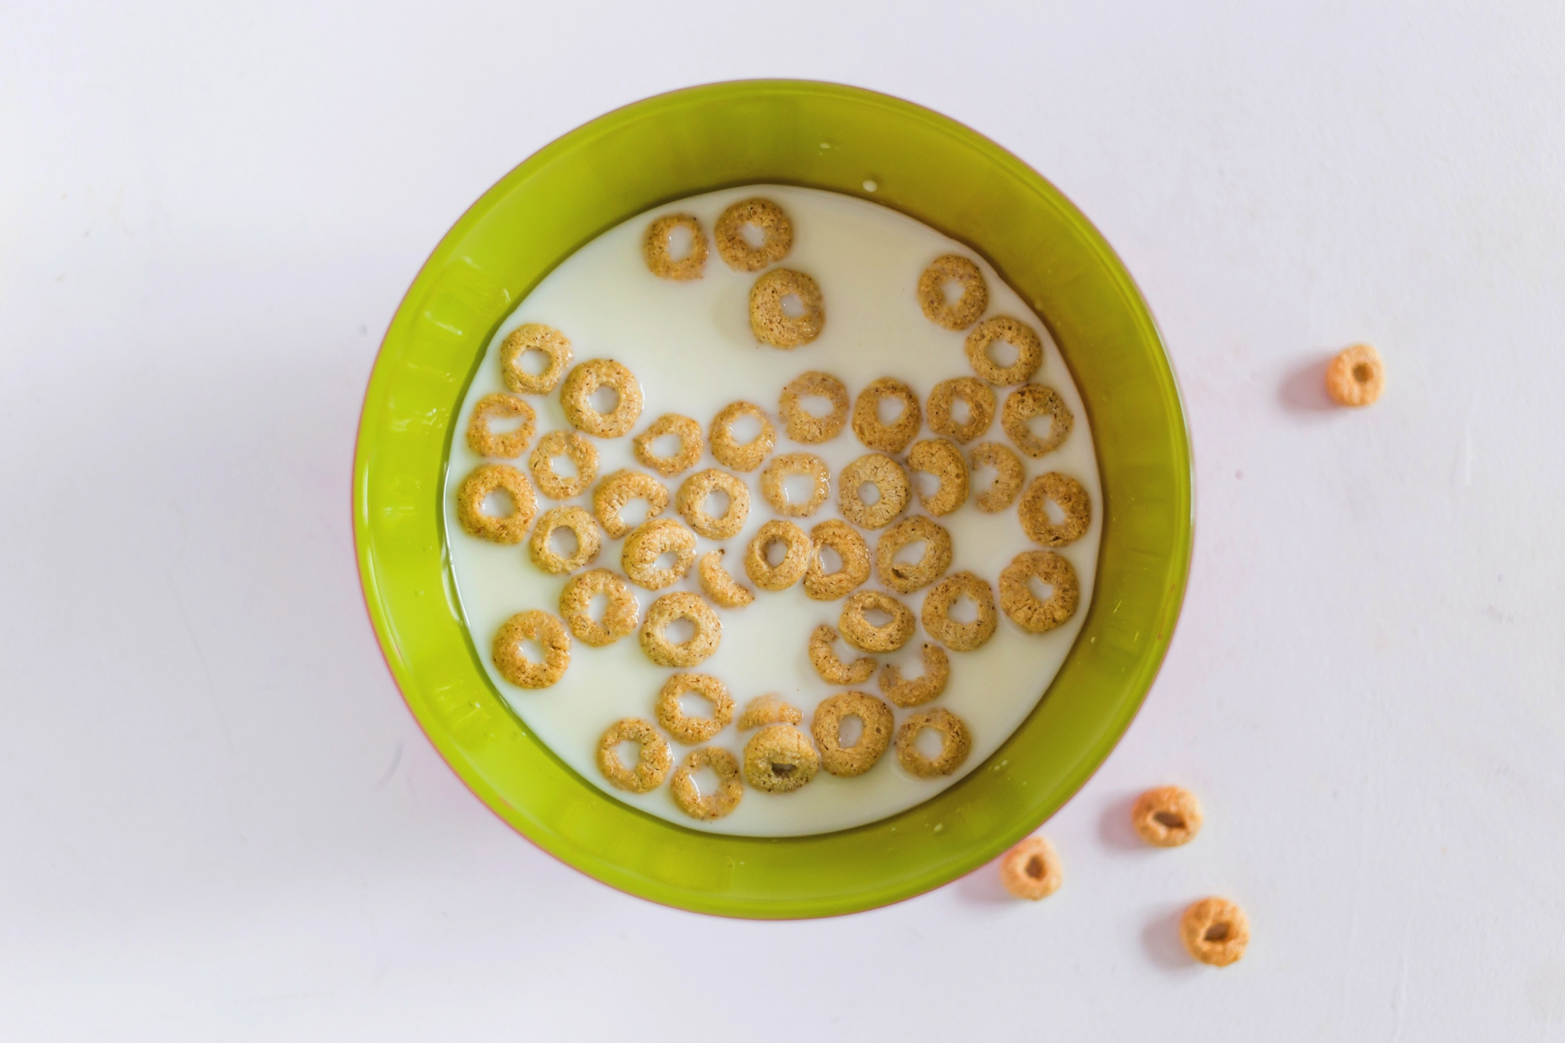
How Can I Help At Home?
Be encouraging
Involve your child in math related activities – cooking!
Have your child explain what he/she is doing
Practice fluency so facts are known with automaticity (computer/Ipad games)
Play math board games
HOP activities
Get a good night sleep
Eat a healthy breakfast
Have a calm morning

